Slide 1
TypeScript Team 3
Mohsena Begum Rimo, Manatsa Chiomadzi, John Duran Contreras, Daniel Helbig, Renuka Maharjan, Waleed Qureshi

Slide 2
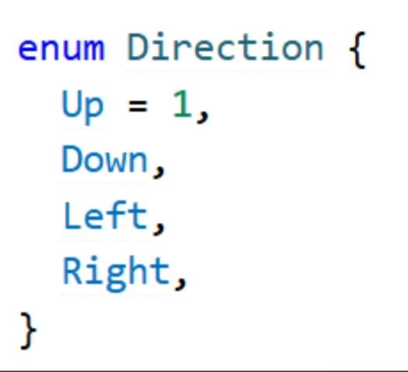
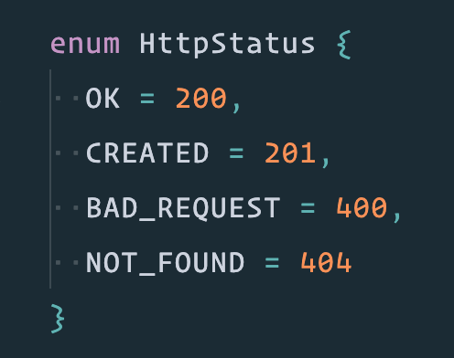
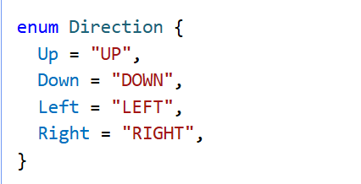
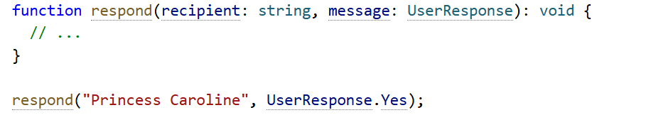
Numeric Enums + String Enums
Enums allow a developer to define a set of named constants. Makes it easier to document intent, distinct cases.
Numerical Enums:
Numbers are incremented, UP - 1, Down - 2, …. Attr -n +1
Strings Enums:
Don't have auto increment behavior each member has to be constant-initialized
String enums serialize well, debugging is easier as you have readable values
You can declare types using the enum name. You can just Access a member by referencing the member as a property of the enum.

Slide 3
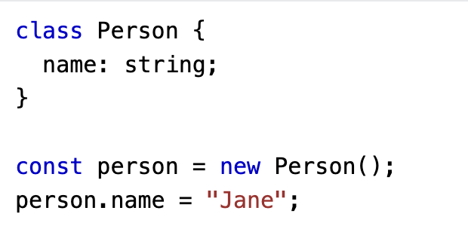
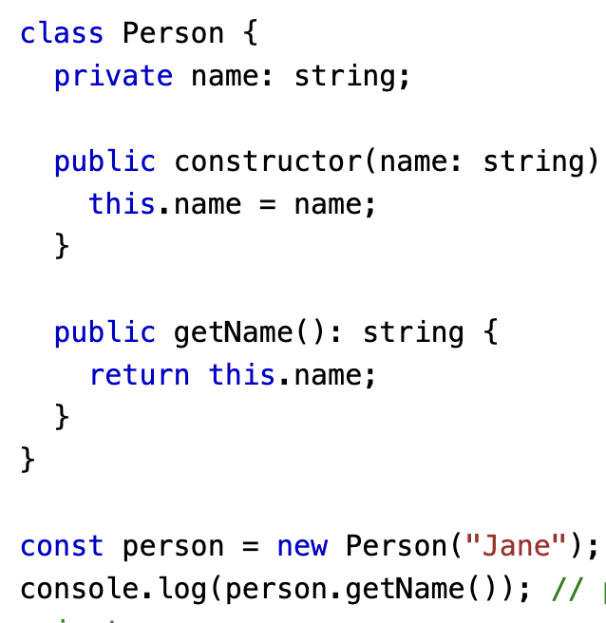
Classes
· blueprint for creating objects with shared properties and methods
· encapsulate related data and behavior together
· to define a class in TypeScript, we use the class keyword
· Inside the class it define properties and methods that belong to that class
· Properties can have types, allows to catch type-related errors at compile-time instead of runtime.
· define access modifiers like public, private, and protected.
· TypeScript supports inheritance, reuse it’s methods and properties

Slide 4
Basic Generics
Generics allow creating 'type variables' which can be used to create classes, functions & type aliases that don't need to explicitly define the types that they use.
Without Generics
Using Generics
//specific type
function echo1(arg: number): number {
return arg;
}
console.log(echo1(13));
//using any
function echo2(input: any): any {
return input;
}
console.log(echo2(20));
console.log(echo2('hello'));
function echo3<T>(input: T): T {
return input;
}
console.log(echo3<boolean>(true));
console.log(echo3<string>('cat'));
function createPair<S, T>(v1: S, v2: T): [S, T] {
return [v1, v2];
}
console.log(createPair<string, number>('car', 42));

Slide 5


Array Generics
Array generics use the same principle as basic generics, but are applied to an array of a type that can be defined later. Although this could be achieved by using the “any” keyword, generics will preserve what type is used after invoking the function, which allows enforcing type safety..

Slide 6
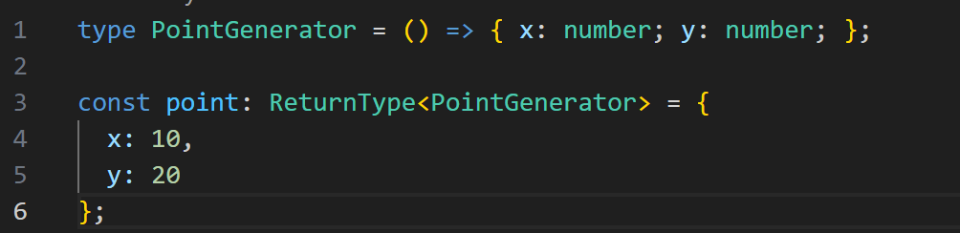
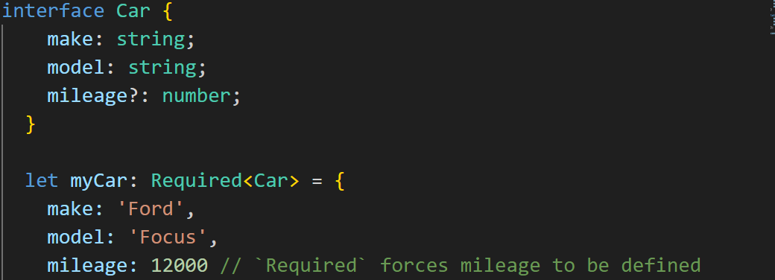
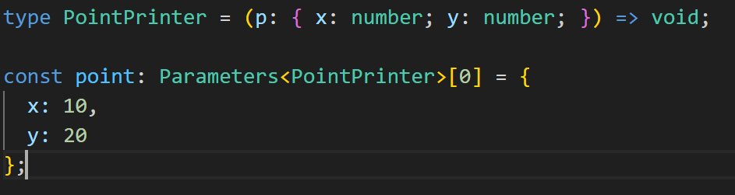
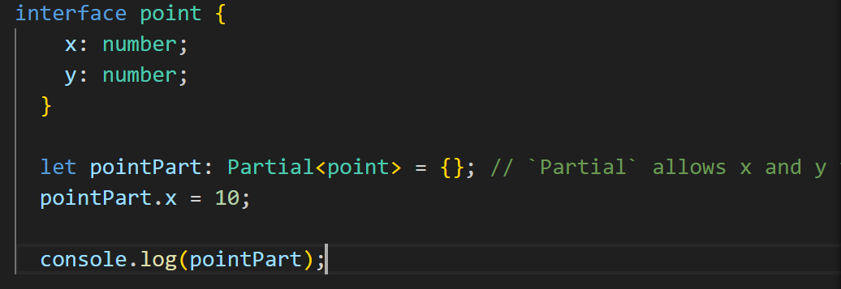
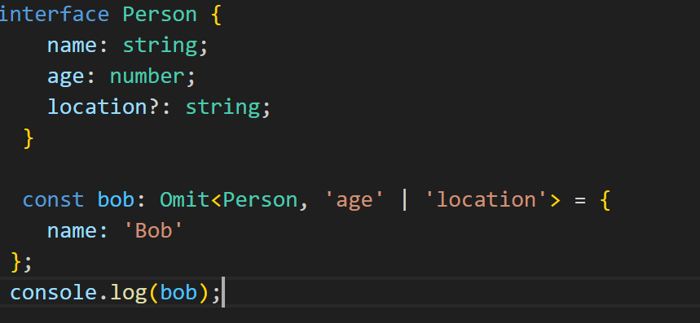
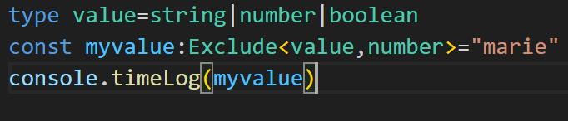
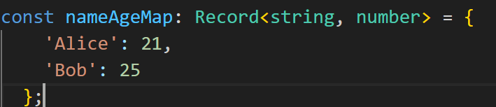
Utility Types
TypeScript utility types are built-in tools that help simplify working with types in TypeScript. They offer shortcuts for common type transformations like making properties optional, extracting certain properties, or filtering out specific types.
Partial: Partial changes all the properties in an object to be optional. Partial<T>
Required: Required changes all the properties in an object to be required. Required<T>
Record: Record is a shortcut to defining an object type with a specific key type and value type. Read<T>
Omit: Omit removes keys from an object type.
Pick: Pick allows to select properties from an existing type.
Exclude: Exclude removes types from a union.
ReturnType:Constructs a type consisting of the return type of function Type.
Parameters Type : takes the parameters or arguments of a function and create a new type based off them.

Slide 7
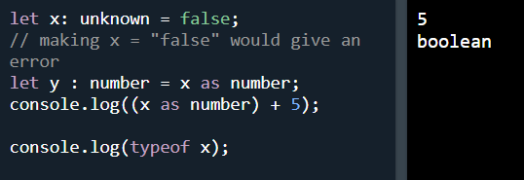

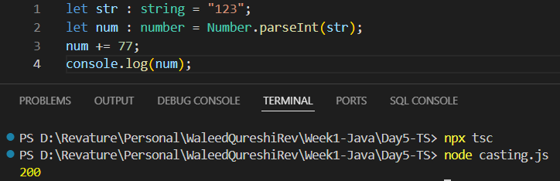
Casting
Type Assertions:
Syntax: either us the “as” keyword or specify datatype like this = <dataype> value
Only works with assertions
Type conversion with assertion will give an error
Happens during runtime, therefore is more efficient
Type Conversion:
Has to be done beforehand, therefore is less efficient.

